Slide 1
SWE2315 : Software REQUIREMENTS & DESIGN
Lecture 05: Process Modelling
At: CIT Theater
By: 2-4pm

Slide 2
Lecture Outline
Process Modelling
Data flow diagrams.
Activity diagrams.
Data Modelling
Entity Relationship Diagram

Slide 3
Process Model
A process model can be used to further clarify the requirements definition and use cases.
A process model is a graphical way of representing how a business system should operate.
A process model can be used to document the as-is system or the to-be system, whether computerized or not.
An organization that create fully dressed use cases may not find that process models add much to their understanding of the system under development.

Slide 4
Data Flow Diagram
The most commonly used techniques to show logical process model is data flow diagramming.
Data flow diagramming is a technique that diagrams the business processes and the data that pass among them.
Although the name data flow diagram (DFD) implies a focus on data, this is not the case.
The focus is mainly on the processes or activities that are performed.
Notes:
When reading a
logical process model, you will not be able to tell whether a process is computerized
or manual, whether a piece of information is collected by paper form or via
the Web, or whether information is placed in a filing cabinet or a large database.

Slide 5
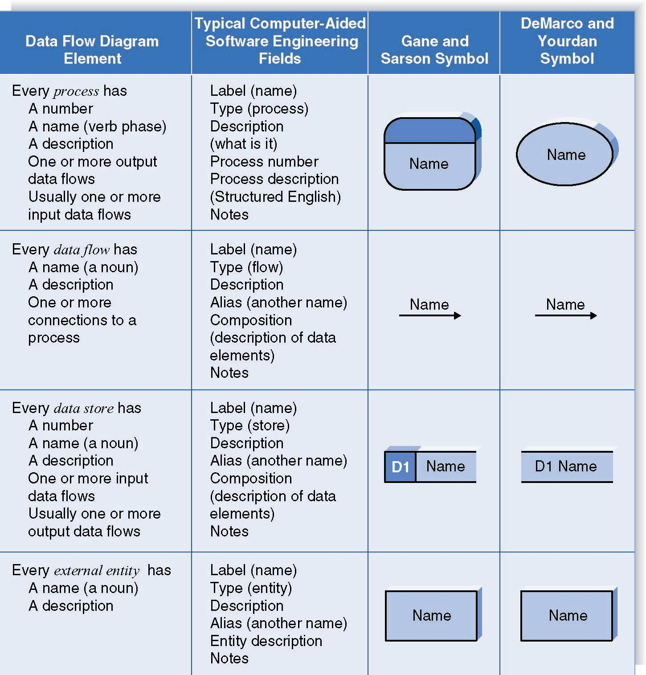

Slide 6
Creating DFD
DFDs start with the information in the use cases and the requirements definition.
DFD integrates the individual use case (example of one use case portion before integrating in next slide).
The project team takes the use cases and rewrites them as DFDs, following the DFD formal rules about symbols and syntax.
Add all inputs and outputs listed on the form of the use cases as data flows.

Slide 7
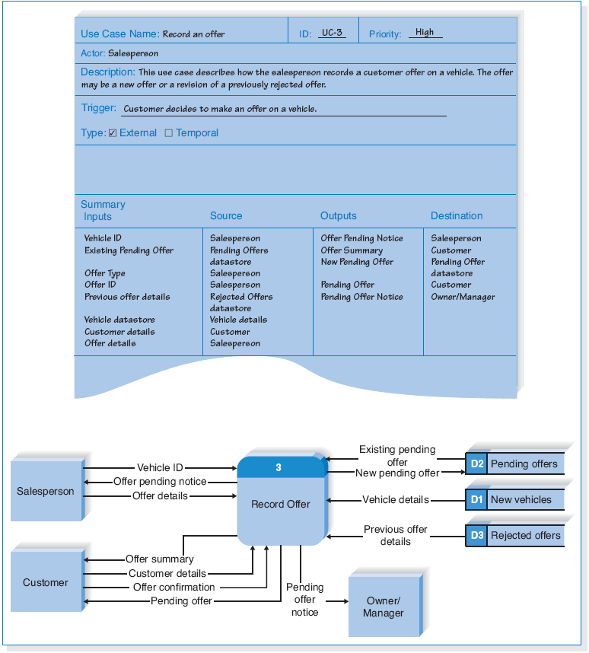
Example-DFD Fragment: Record Offer

Slide 8
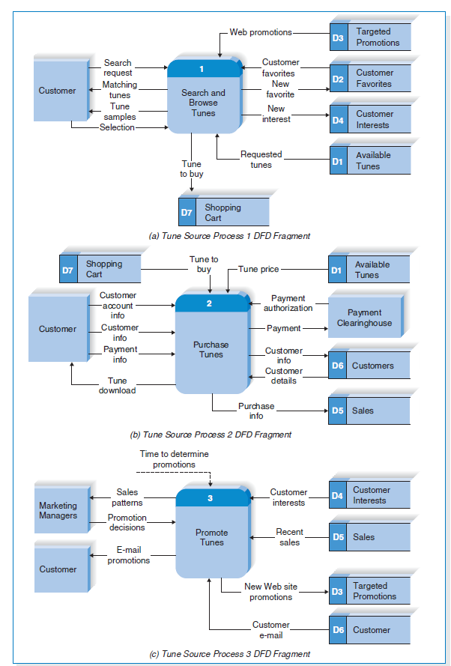
DFD TUNE SYSTEM

Slide 9
Activity Diagram
Activity Diagrams illustrate the dynamic nature of a system by modeling the flow of control from activity to activity.
Activity diagrams are very similar to the old fashioned flow charts which used to be the most popular means of diagrammatically showing the analysis and design of programs.
For complex system each user task may be converted to an activity diagram to understand the normal and alternative section of the use case more.

Slide 10
Example 1: Activity Diagram for Borrow Book User task
The steps for borrowing identified during elicitation is given below:
After user identity is checked by scanning card, the system check the corresponding personal loan records and the overdue fine, if any.
If there is no outstanding fine, the system allows the user to borrow books within the available loan limit and prints a loan receipt. Otherwise, the system does not allow further loans for the user and prints a charge notice.

Slide 11
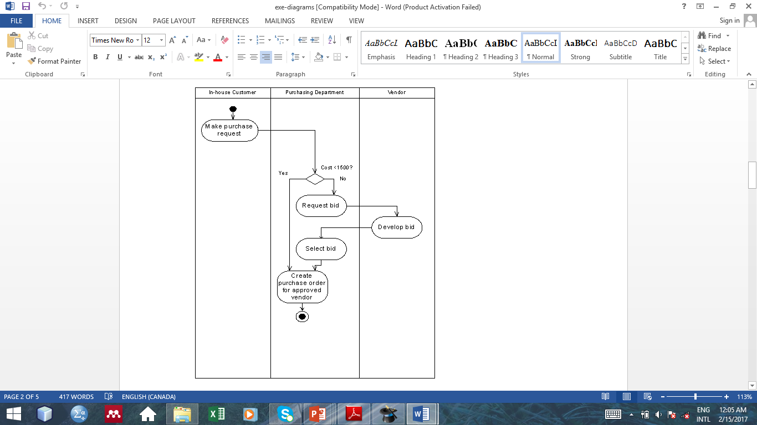
Example 2 : Activity Diagram for Purchase Request User task
An in- house customer would initiate a purchase request and a staff within the Purchasing Department receives the request and monitors it.
The Staff then processes the request if it is under N 1500 creates a purchase order and then sends it to vendors.
Purchase requests over N 1500 must first be sent out for bids from the vendors that supply the product. When the bids return, the staff selects one bid. Then, the staff writes a purchase order and then sends it to the vendor.

Slide 12
Data Model
A data model is a formal way of representing the data that are used and created by a business system.
An entity-relationship diagram (ERD) is usually used to show data modelling.

Slide 13
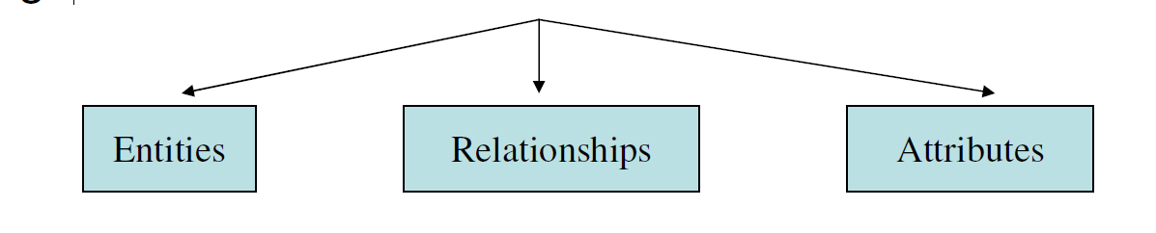
ERD
An entity-relationship diagram (ERD) is a diagram showing the information that is created, stored, and used by a business system.
It is a detailed logical representation of data for an organization and uses three main constructs:

Slide 14
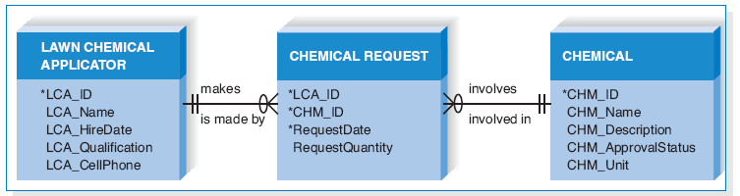
Example of an Entity Relationship Diagram

Slide 15
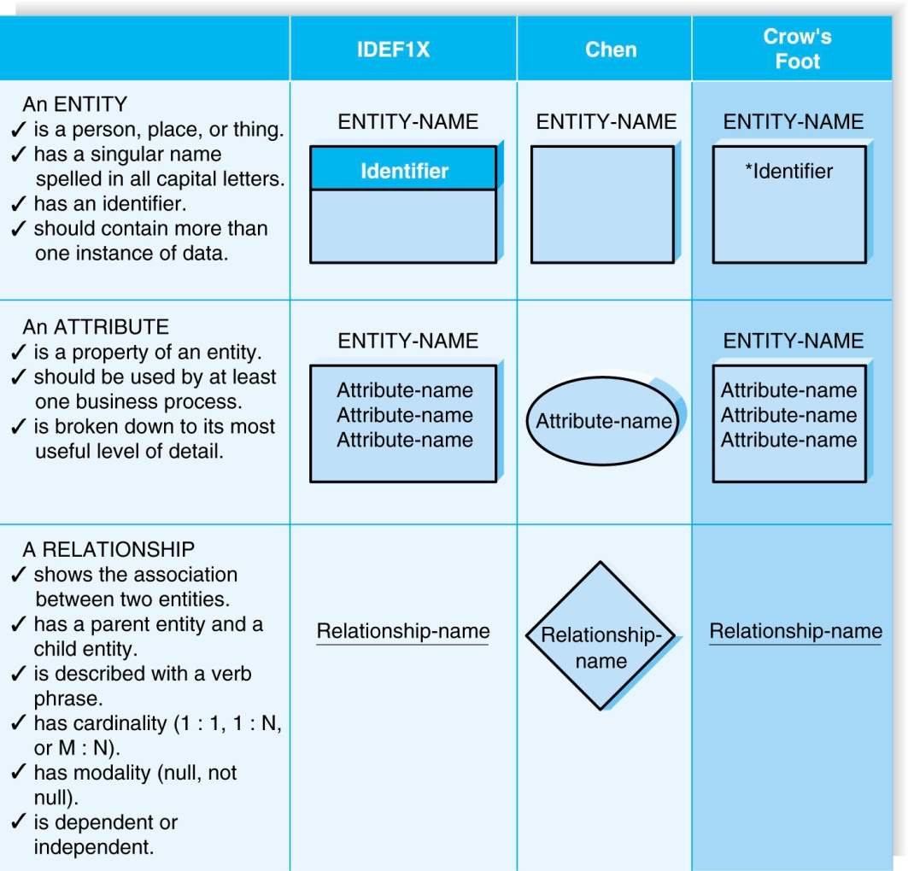
Elements of an ERD

Slide 16
Entity
The entity is the basic building block for a data model. It is a person, place, event, or thing about which data is collected.
Entities represent something for which there exist multiple instances, or occurrences.
Entity is the description of all entities to which a common definition, common relationships and attributes apply.

Slide 17
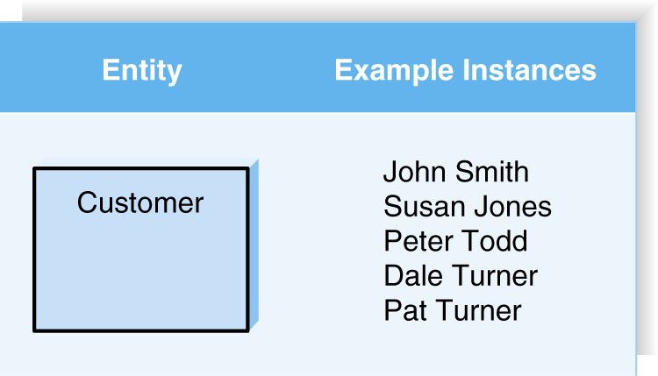
Entity
E.g., John Smith could be an instance of the customer entity.

Slide 18
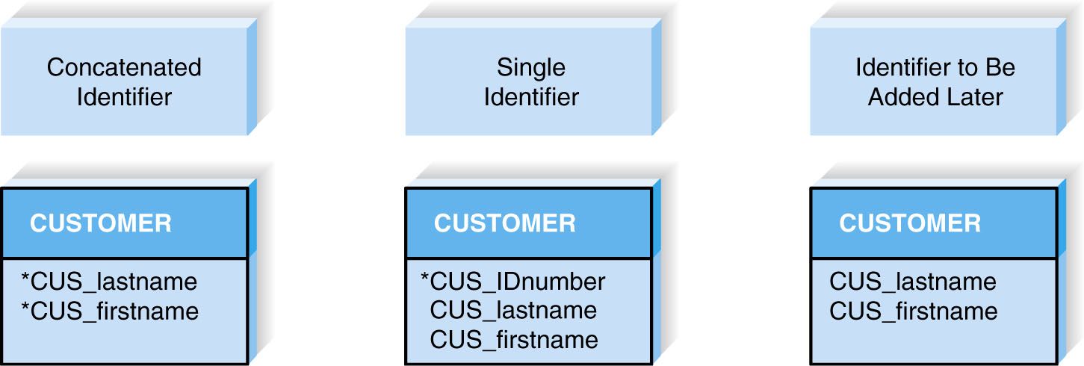
Attributes
An attribute is some type of information that is captured about an entity.
Attributes are nouns that are listed with an entity.
One or more attributes can serve as the entity identifier - the attribute(s) that can uniquely identify one instance of an entity.
Concatenated identifier - several attributes are combined to uniquely identify an instance.

Slide 19
Relationships
Relationships are associations between entities.
A relationship is a reason for associating two entity types.
Every relationship has a parent entity and a child entity.
Relationships should be labeled with active verbs.
Example
A Lawn Chemical applicator makes a chemical request.
A chemical Request involves a Chemical

Slide 20
Relationships
Relationship
Cardinality
1:1
1:N
M:N
Modality
Null
Not Null

Slide 21
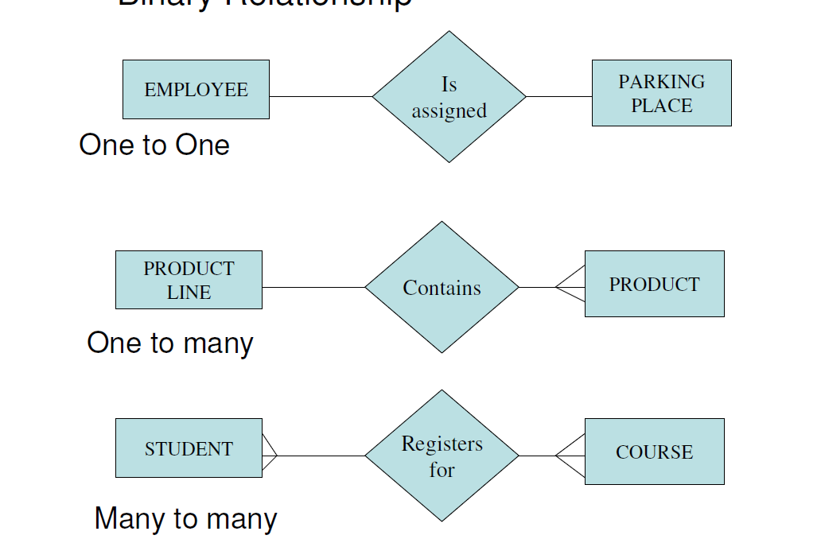
Cardinality
For cardinality, ask how many instances of each entity participate in the relationship.

Slide 22
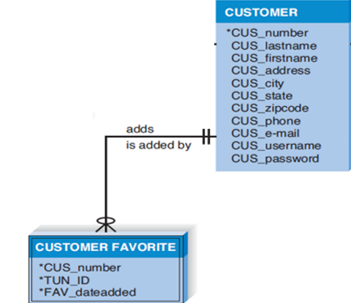
Modality
A relationship has modality of null or not null
Null means that an instance of a child entity can exist without a related instance in the parent entity.
Not Null means that an instance of a child entity can’t exist without a related instance in the parent entity.
Example: Customer can exist without a targeted promotion, so the modality is “null”; However, a targeted promotion requires the existence of a customer, so the modality is “not null.”

Slide 23
Steps for CREATING (ERD)
1. Identify the entities
2. Add the appropriate attributes to each entity
3. Draw relationships among entities.

Slide 24
Step 1: Identify the Entities
The entities should represent the major categories of information that you need to store in your system.
look at the data stores and external entities.
Before including external entities and ask yourself, “Will the system need to capture information about any of these entities?”

Slide 25
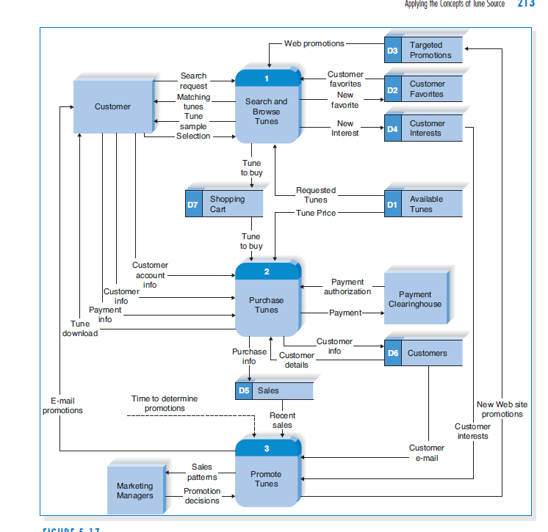
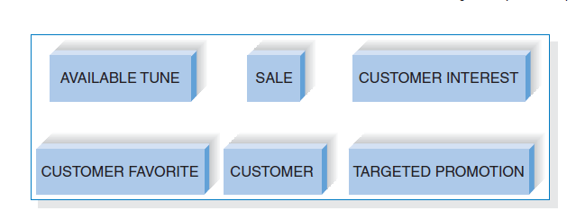
Step 1: Example
Entities from Datastore

Slide 26
Step 2: Add Attributes and Assign Identifiers
The information that describes each entity becomes its attributes.
Use requirements elicitation techniques (e.g., interview and document analysis).
Check the process model for details on data flows and data stores.
One or more of the attributes will become the entity’s identifier.

Slide 27
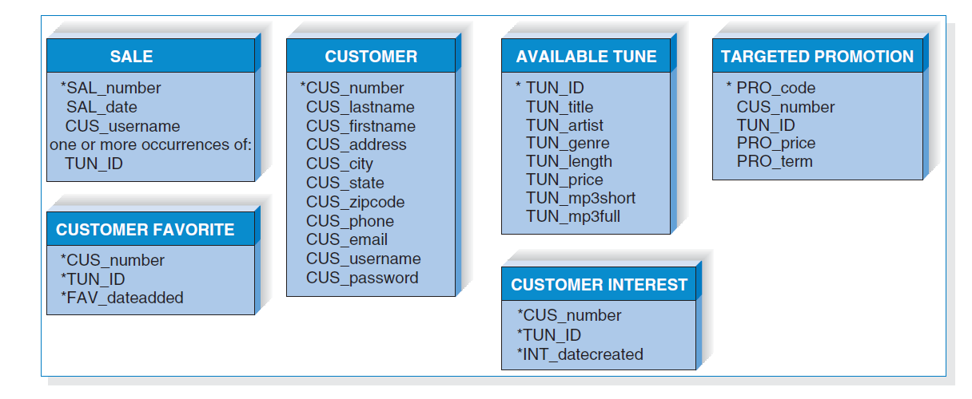
Step 2: Example

Slide 28
Step3: Identify Relationships
The last step in creating ERDs is to determine how the entities are related to each other.
Lines are drawn between the entities that have relationships.
Each relationship is labeled, and cardinality and modality are assigned.

Slide 29
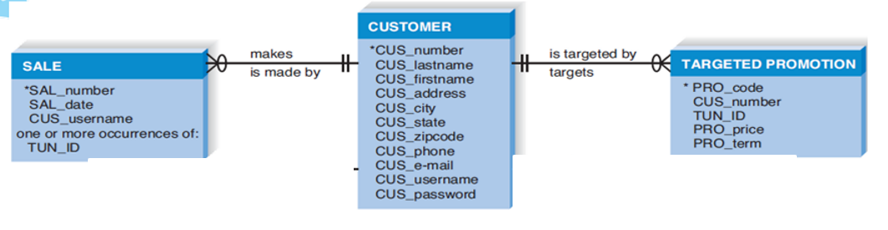
Modality Example
Can an customer exist without an associated sale? In our example, the answer is “yes,” so the modality is “null” or not required. A zero is placed next to the crow’s foot near the sale.
Now, can a sale exist without an associated customer? This answer is “no,” so the modality is “not null”: or required, and we place a bar next to the customer entity
Customer can exist without a targeted promotion, so the modality is “null”; However, a targeted promotion requires the existence of a customer, so the modality is “not null.”

Slide 30
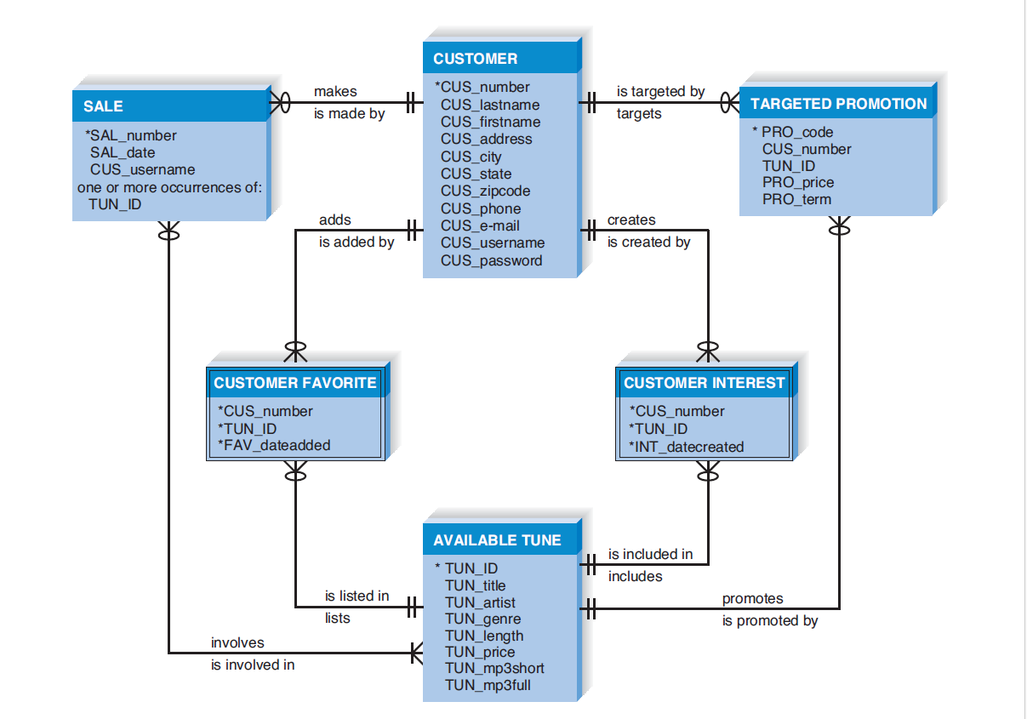
Step3: Identify Relationships

Slide 31
Task 4
For 1/3 of the Design Team
- Create DFD or Activity Diagram for the three(3) use case description of task 3
-Create an ERD for the system.

Slide 32
Summary
Data flow diagramming is a technique that diagrams the business processes and the data that pass among them.
Activity Diagrams illustrate the dynamic nature of a system by modeling the flow of control from activity to activity.
An entity-relationship diagram (ERD) is a diagram showing the information that is created, stored, and used by a business system.

Slide 33
Question?

